Slide 1
07 Lab – Signal Down Counter
Mary Hager

Slide 2
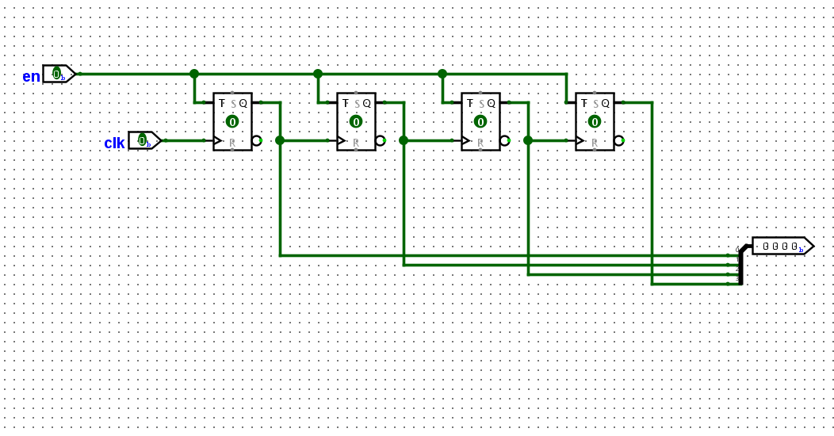
Down Counter

Slide 3
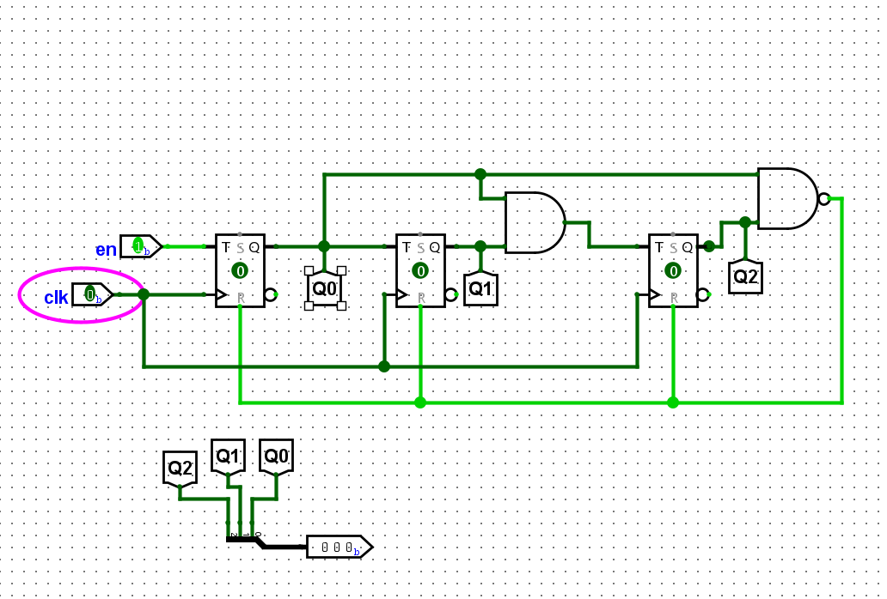
Mod 5 - attempt 1
ISSUE: Reset pins did not have an inverter

Slide 4
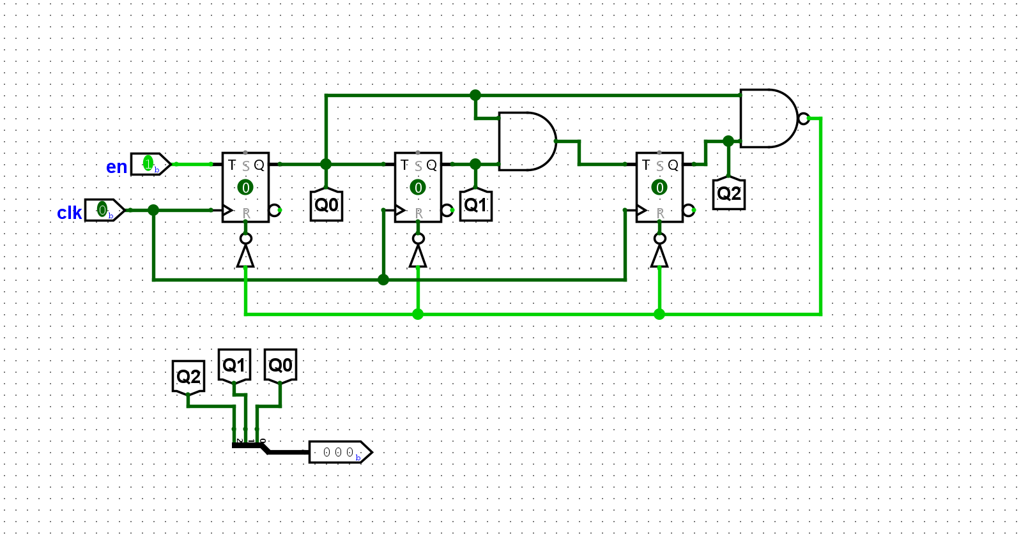
Corrected Mod 5

Slide 5
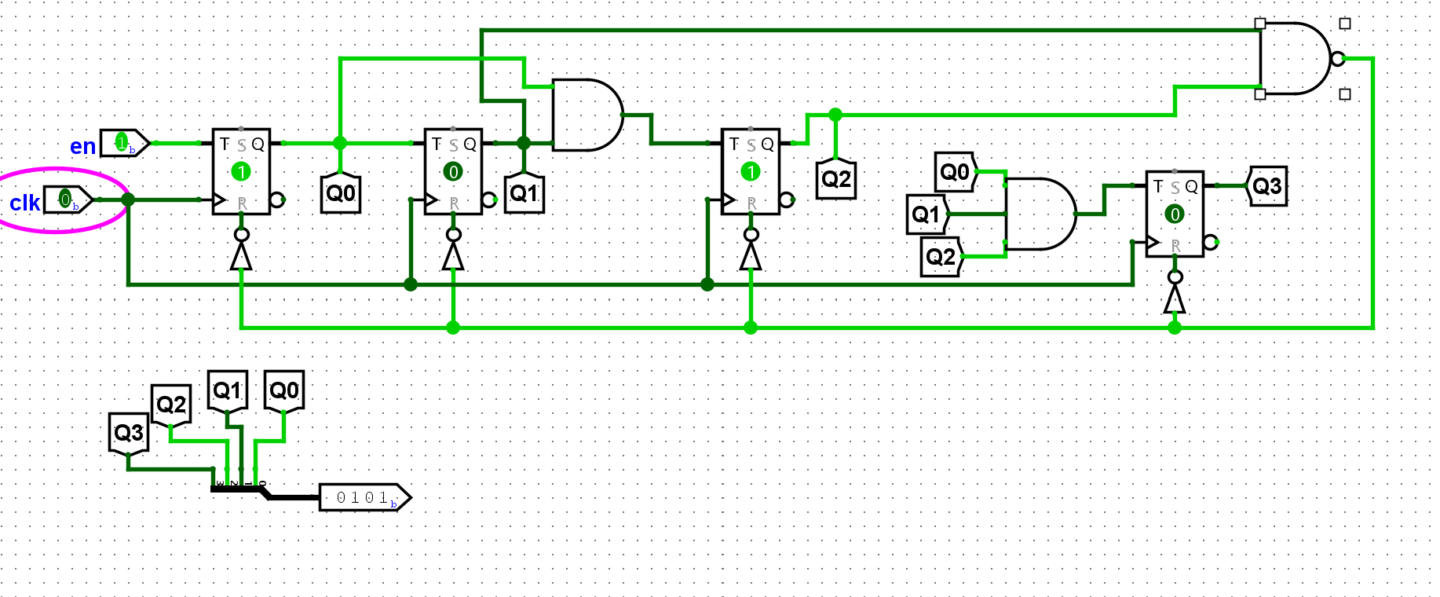
10 M0D
Behavior = count up to 10 then reset

Slide 6
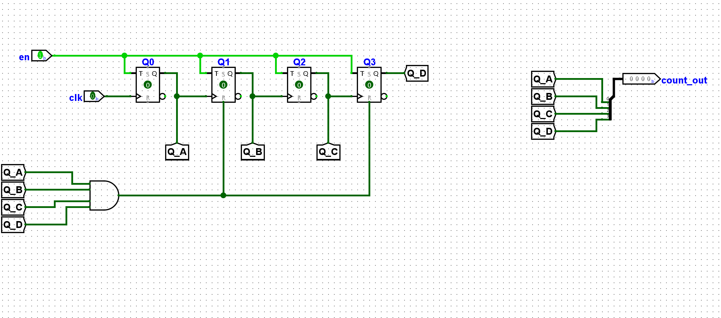
Count Down – 5 to Zero
Successfully Works

Slide 7
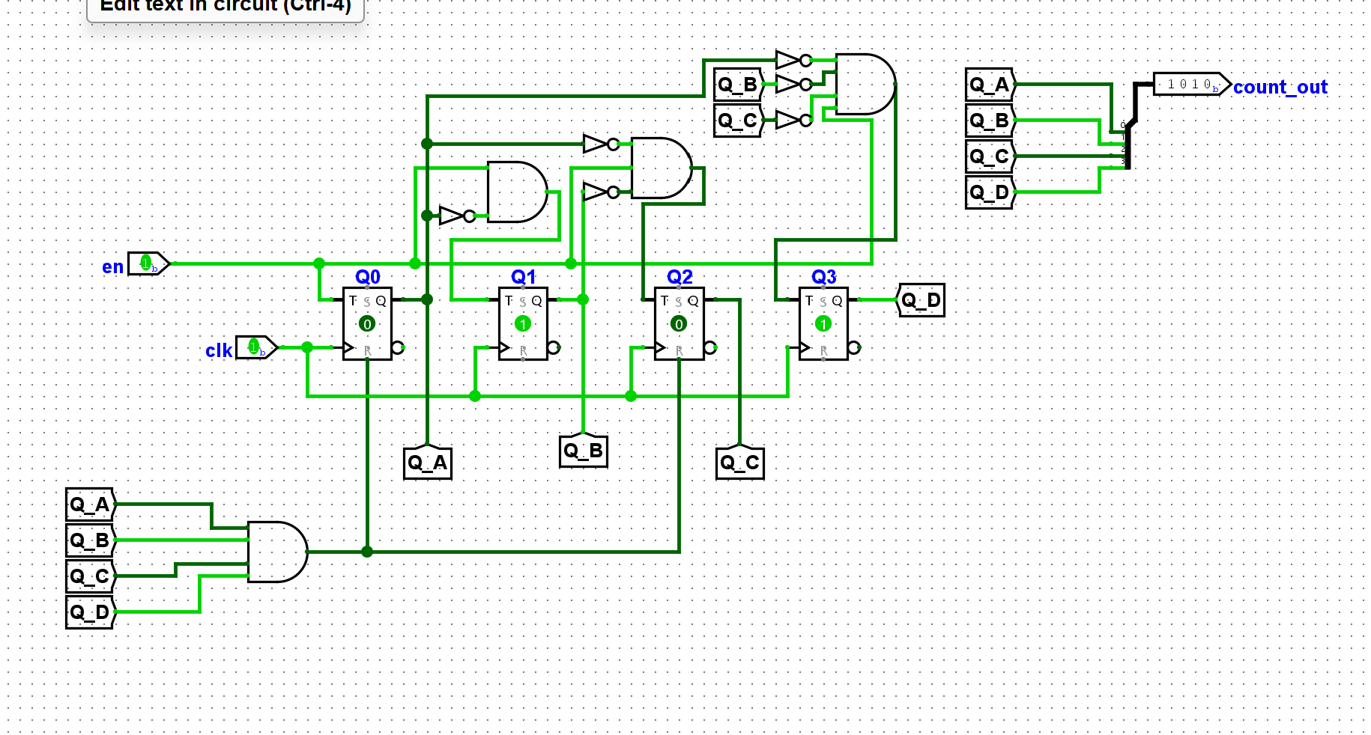
Successfully Counts Down from 10 to 0 as the Clock Moves
Based on the MOD-10 Up Counter - the T pin should become enabled when the previous value(s) are zero (when counting down).

Slide 8
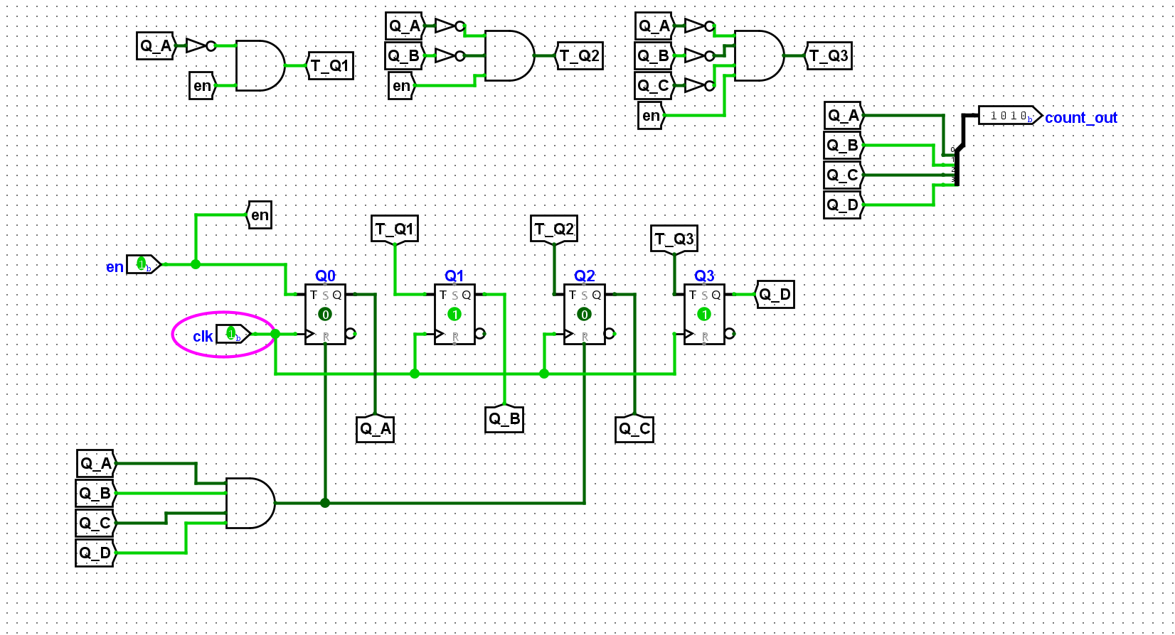
Diagram of DownCounter_10 Cleaned Version

Slide 9
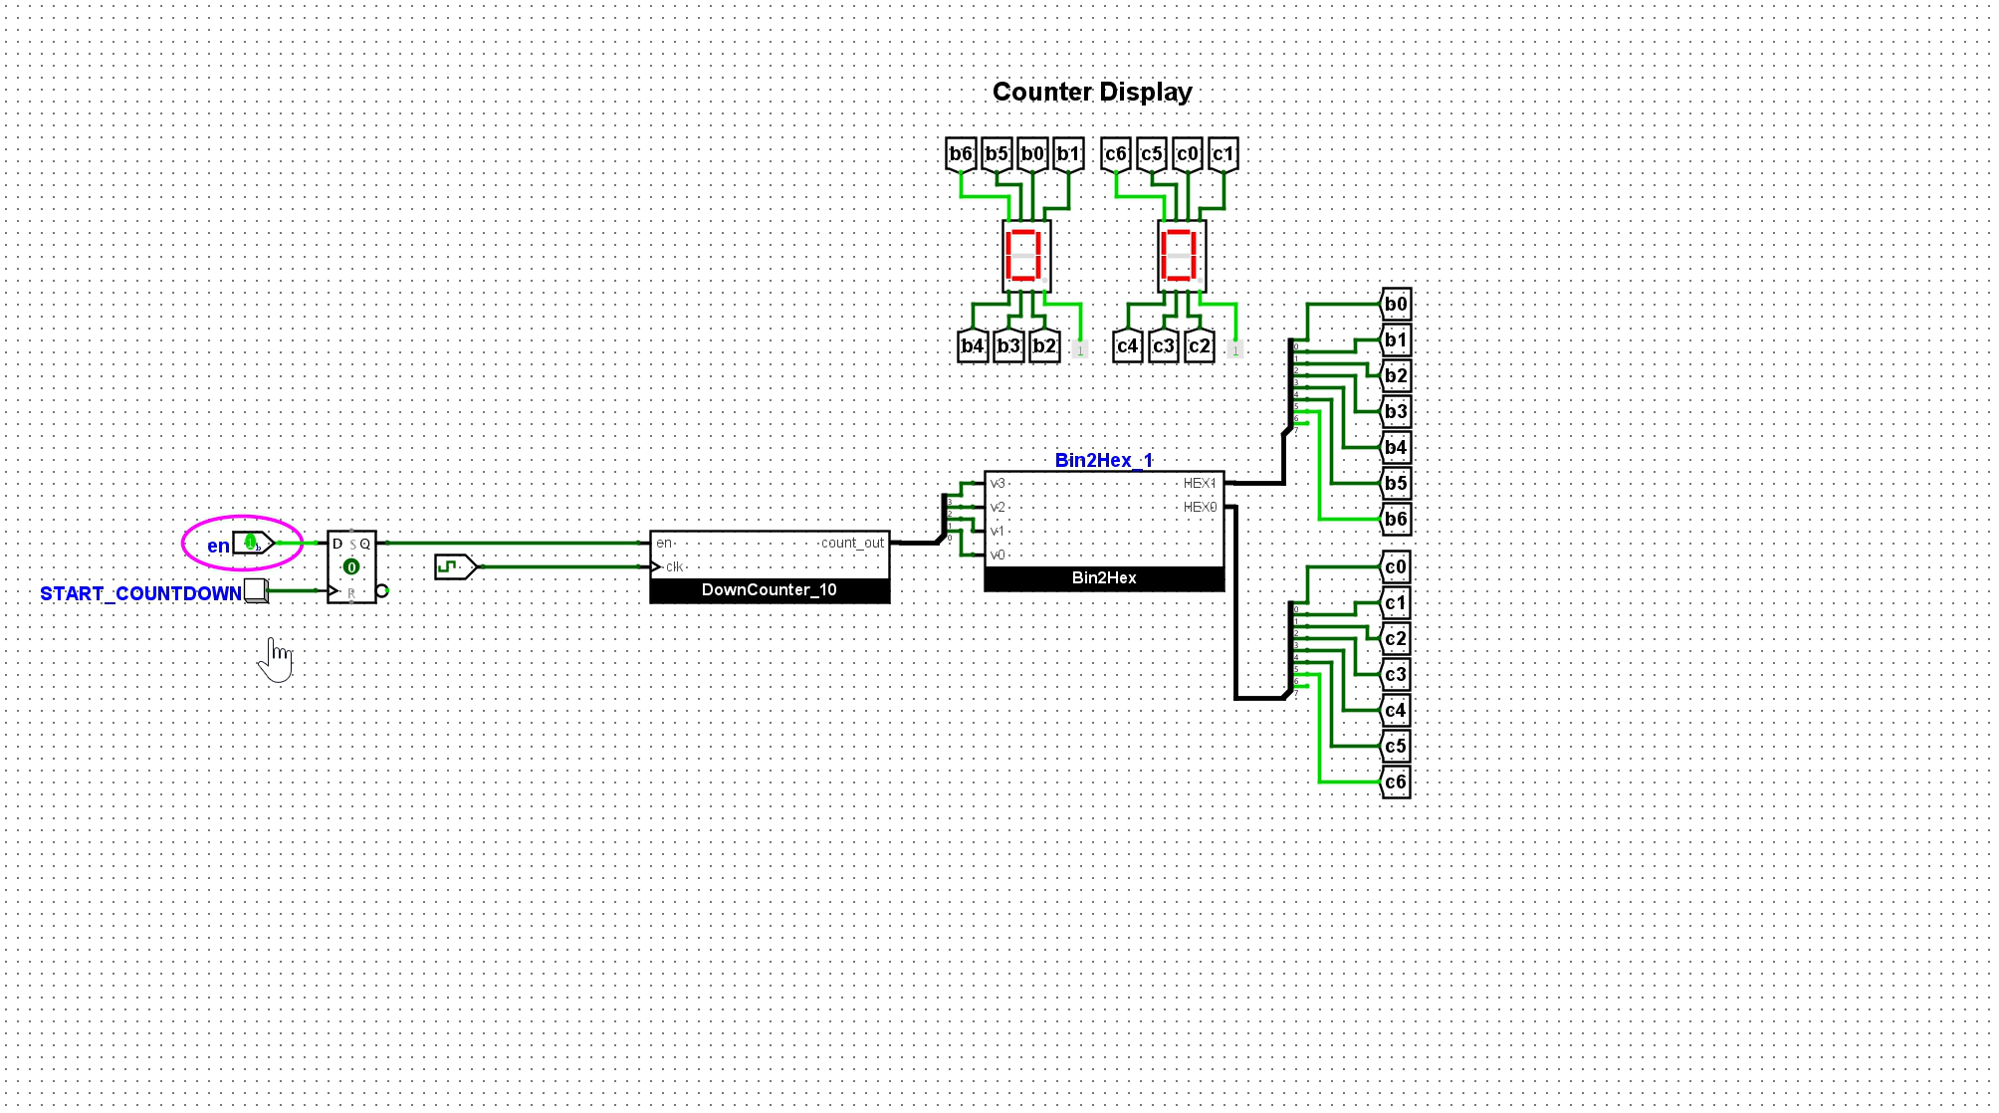
Media Content of 10 Second count-down initiating when button is pressed
Remaining Task: Stop the countdown when 0 is reached

Slide 10
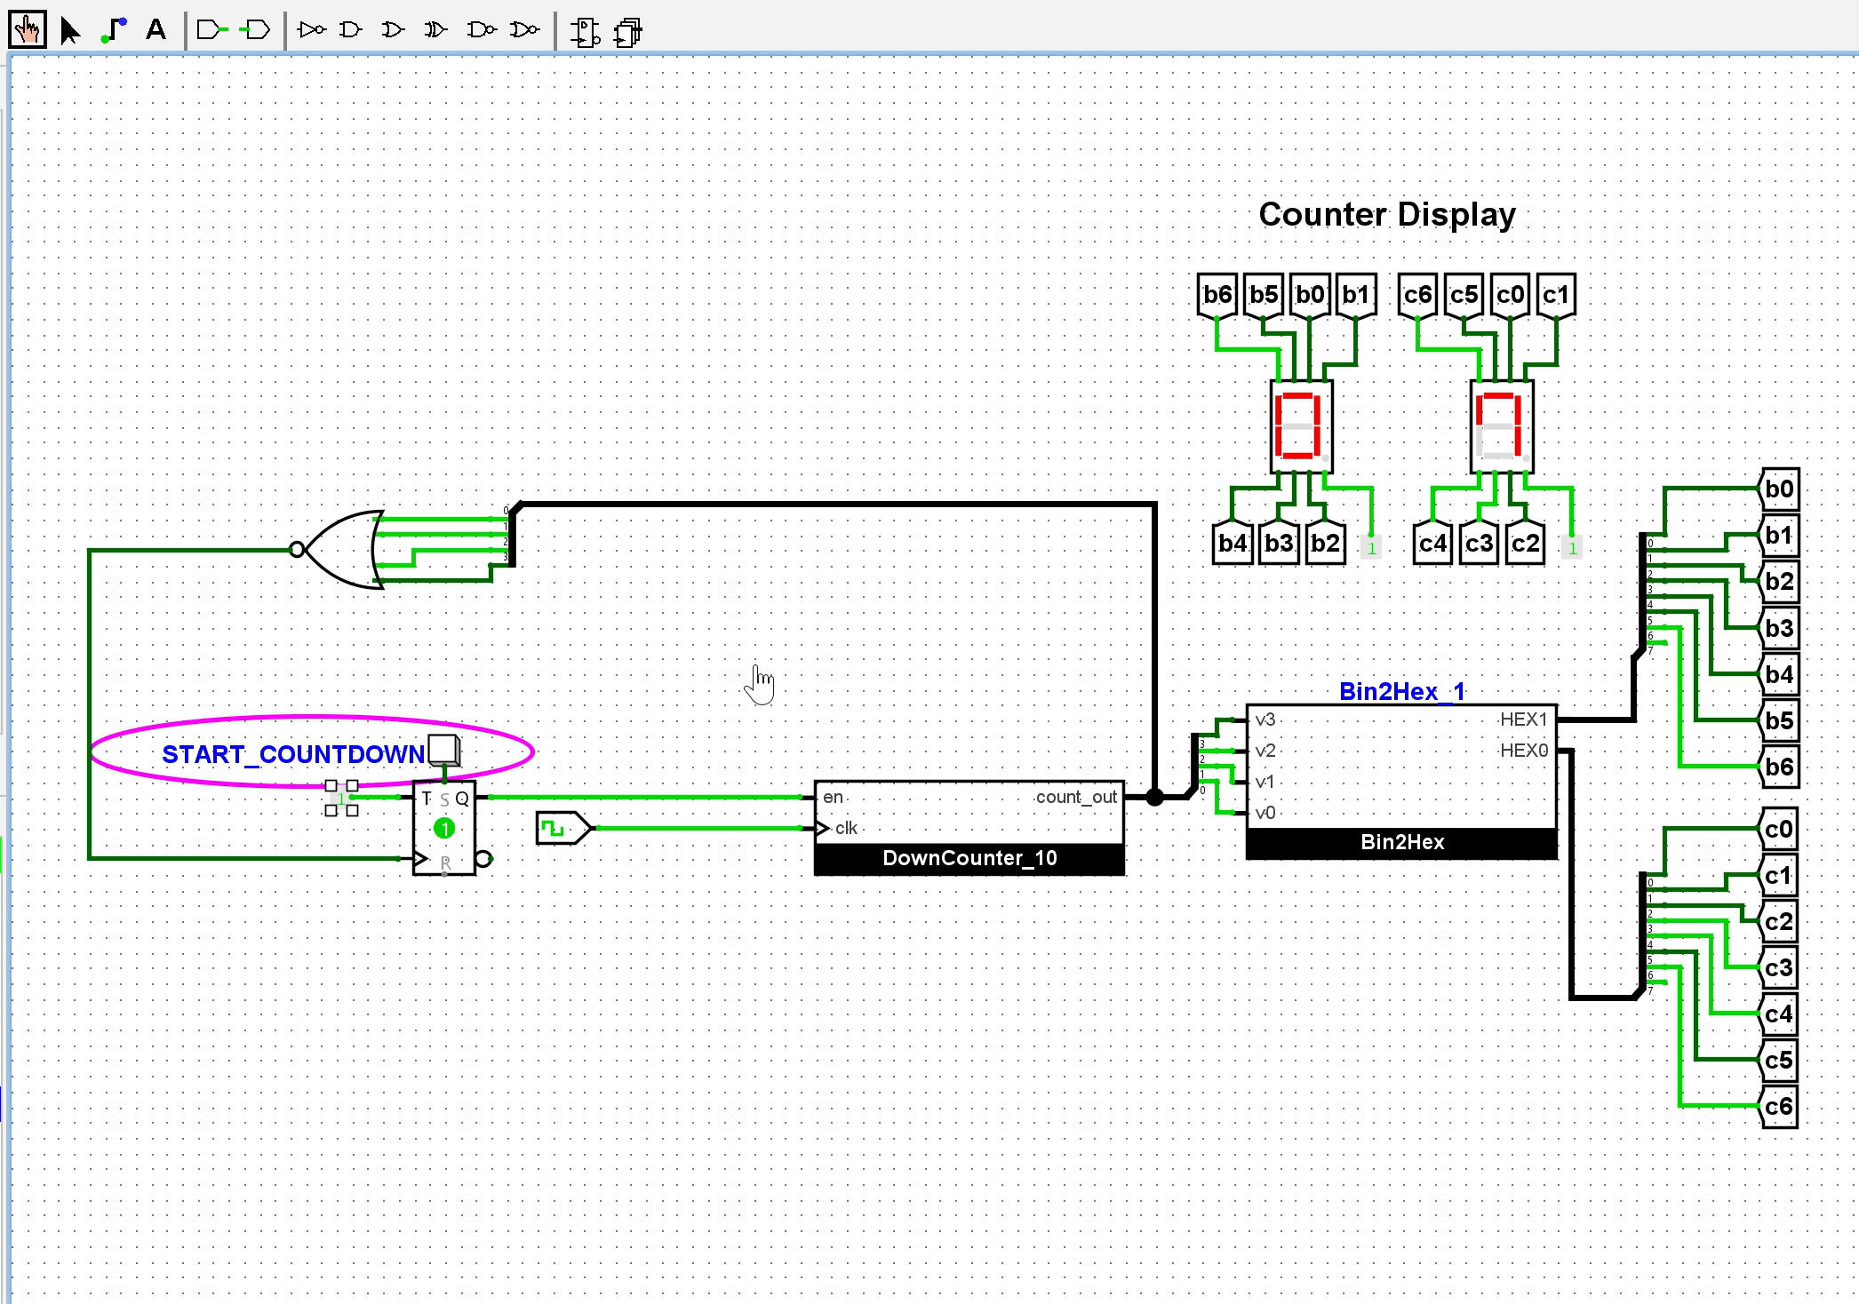
Completion of Task
Inverter Pin Becomes 1 when the bits are 0000 via NOR.
This turns “on” the T Flip-Flop
The value of 1 is pushed “out” using the select pin. This only occurs when the button is pressed.

